Slide 1
Using Python with VS Code
[Speaker]
[Company]
Email: [Email]
Twitter: [Twitter]

Slide 2
Agenda
Brief introduction to Python
Python with Visual Studio Code
The Python Ecosystem

Slide 3
Brief Introduction to Python

Slide 4
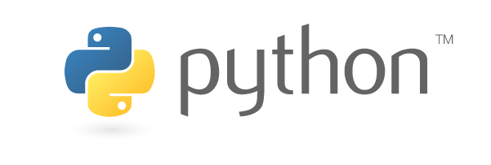
Python
Python is a object oriented or structured, high-level, interpreted, dynamically typed programming language.
It was originally created in 1991 by Guido van Rossum.
Python aims to be readable code.
According to a September 2016 GitHub survey, Python is the 3rd most popular language after JavaScript and Java.
Notes:
Python was original created as a hobby project by Guido van Rossum in 1991 and was cheekily named after Monty Python. The principal driver behind the project was readability as opposed to languages like C or C++ that use brackets and other conventions.
Python is a cross-platform, mixed paradigm language, being object oriented or structured. It is also a high-level, interpreted language similar to languages like PHP or JavaScript. It’s versatility makes it useful for all sorts of applications including general purpose scripting as well as more sophisticated desktop apps and web apps.
Python has enjoyed a revival in recent years in academia and among developers because of its versatility. Python’s readability makes it user friendly. This combined with its powerful mathematic libraries makes it popular with researchers. Computer Science schools have embraced it because it makes it easier to focus on teaching programming paradigms rather than syntax.
Developers use python scripting for applications and build automation alike. It’s cross-platform appeal delivers write once, run anywhere in the vein of JavaScript and PHP.

Slide 5
Python Data Types
Python data structure nomenclature for set data can be quirky for experienced developers.
List – a list can contain any sort of data type. Lists are mutable and focus on order with the intent of working on items
Dict – a set of key-value pairs
Tuple – a set of data that is immutable. Tuples focus on structure with the intent of working on the tuple as a unit.
Notes:
Python supports most all conventional data types. Python doesn’t have arrays per se, rather a variety of data structures that work like arrays do in other programming languages including Tuples and Lists.
Lists are intended to group sets of data together where the focus is on the individual items. The functionality lists provide works around ordering the data, however operations are intended to be performed on the items themselves.
Tuples, on the other hand do not focus on the items in the list or order, rather focus on the data in the tuple as a unit. The focus of tuples is structure.
Dicts work like associative arrays or dictionaries, depending on the language. They contain sets of key-value pairs.

Slide 6
Python
Instead of brackets and semicolons, Python uses indentation and lines to structure code and flow control.
y = 1
if y == 1:
print “Y, hello world.”
Notes:
For new developers, finding simple syntax errors like semicolons and lining up curly brackets can be a daunting task. With readability being one of main goals of Python, the language is structured using indentation. Code blocks are defined by the nested code in the block being more indented that the containing block. This is true for loops, conditionals, methods, and classes.

Slide 7
Python
Python has first class functions, so they are registered as objects in Python.
Python also supports lambda function too.
def call_func(f, *args):
return f(*args)
call_func(lambda x, y: x + y, 2, 2) #output is 4
Notes:
Python functions are first class functions, meaning that they themselves can be treated like objects in the program itself. Python also supports lambda functions (a.k.a. anonymous functions) too, which allows these to be defined inline. Python uses the def keyword to define named functions.

Slide 8
Learning Python
Python’s simplicity makes it easy to learn
There are a number of great online resources that teach Python:
http://www.learnpython.org/
https://www.python.org/about/gettingstarted/
Notes:
There are a number of great resources online for learning Python, and it requires virtually no prior experience programming in order to learn.
learnpython.org is probably the most popular site for learning how to use Python. It has an integrated execution environment so that students don’t have to install Python to use it. Each lesson is a simple, one page tutorial that walks the learner through the basic of Python programming.
The Python Software Foundation (python.org) also has a number of tutorials for getting started with Python.

Slide 9
Learning Python
Python’s simplicity makes it easy to learn
There are a number of great online resources that teach Python:
http://www.learnpython.org/
https://www.python.org/about/gettingstarted/
Notes:
There are a number of great resources online for learning Python, and it requires virtually no prior experience programming in order to learn.
learnpython.org is probably the most popular site for learning how to use Python. It has an integrated execution environment so that students don’t have to install Python to use it. Each lesson is a simple, one page tutorial that walks the learner through the basic of Python programming.
The Python Software Foundation (python.org) also has a number of tutorials for getting started with Python.

Slide 10
Python with Visual Studio Code

Slide 11

Visual Studio Code and Python
Visual Studio Code requires that Python be installed separately, however this is easily accomplished by using one of the many platform specific installers.
https://www.python.org/downloads/
Notes:
Python itself doesn’t requires an IDE to use, however having an IDE handy makes the development experience my fluid. Visual Studio Code integrates unobtrusively with existing Python installations. Many POSIX compatible systems such as OSX and Linux will often times install Python with other software, as a lot of software on these platforms use Python. However if it is not installed, Python is easy to install with one of the many available installation packages from Python, including ones for Windows and Mac OSX. Check out https://www.python.org/downloads/ to find these packages.

Slide 12
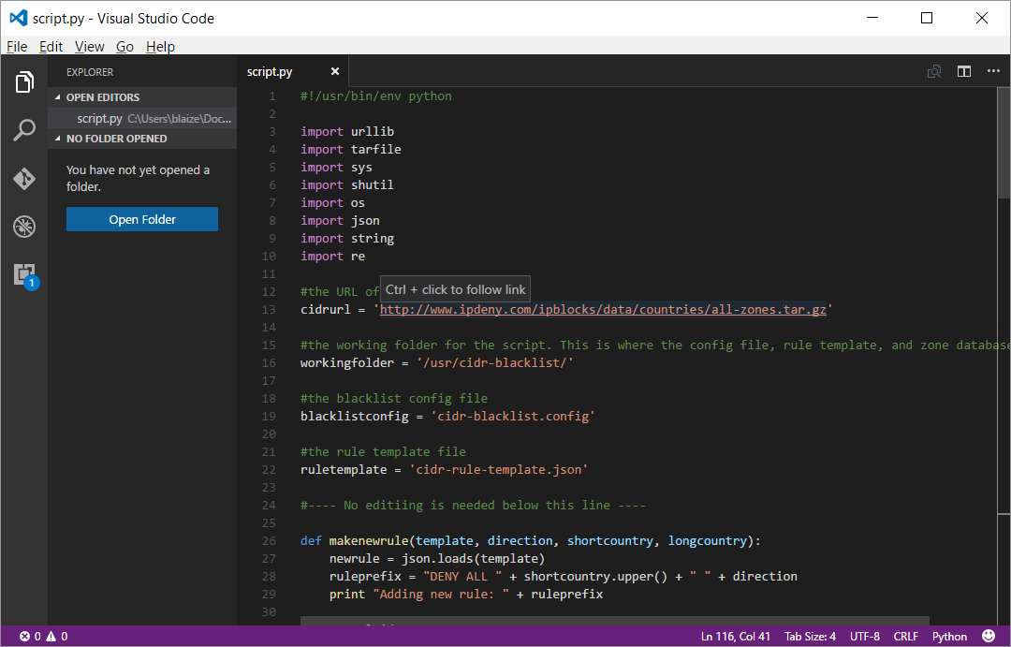
Visual Studio Code
Visual Studio Code (VS Code) is a free, cross-platform IDE designed for all sorts of languages including Python.
VS Code is available on Mac, Windows, and Linux.
VS Code has built in support for git and GitHub
https://code.visualstudio.com/
Notes:
Microsoft introduced Visual Studio Code as a cross-platform tool for developers to have a lightweight IDE with many of the beloved features of Visual Studio including extensibility, code-highlighting, integrated debugging for many languages, and Intellisense.
Microsoft also included built in support for Git and GitHub as convenient way to access code repositories without the need for third-party tools.

Slide 13
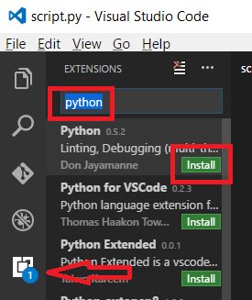
Visual Studio Code and Python
Visual Studio Code can be extended to be tightly integrated with Python.
It offers all the loved features of debugging integrated with VS Code
Notes:
Python on Visual Studio Code has tight integration with Python and VS Code through the Python extension. The extension requires that Python be installed separately, but once Python and the extension are installed, the extension will automatically hook into python and the IDE to provide the integrated development experience expected from an IDE. Combined with the other features of VS Code, this offering makes for a full featured Python development experience not found in other IDE’s

Slide 14
Visual Studio Code and Python
The integrated Python debugger offers many common features of a debugger including:
Linting – The linting suggestions made by Python help prevent potential bugs
Intellisense – This helps developers complete lines of code automatically.
Interactive Debugging – Developers can step through code a line at a time and see the values of variables, have a terminal to evaluate Python commands in real time, and even change variables.
Notes:
Using Visual Studio Code with Python helps developers write apps in the same way they can using much heavier programs. Visual Studio Cod brings many of the most loved features of Visual Studio to Python. Some of these features include, but are not limited to Linting to help prevent bugs, Intellisense for aiding code completion, and interactive debugging.

Slide 15
The Python Ecosystem

Slide 16
Python 3 vs Python 2
Python has two major supported versions including Python 2 and Python 3.
Python 2 is an extended End-of-Life version of Python to continue to provide support for many legacy Python apps.
Python 3 is the latest version. For new development, use Python 3, as most major packages support this version now. Likewise, it has better performance and other enhancements.
Notes:
Many new Python developers can be confused between Python 2 and Python 3. While generally speaking, there is a lot of shared knowledge between these two versions, however Python 3 is not fully backwards compatible with Python 2.
Python 2 was given a long End-of-Life because of the shear number of apps and scripts written in Python. It isn’t, however, receiving any new features under the extended EOL.
Python 3 is the latest version, and should be the version of choice for new development. It also has better support for internationalization and other such features that make it more appealing to a global audience.

Slide 17
The Interpreter
Python is an interpreted language, which means that it isn’t compiled into a set of binary files. Rather each line of the app is compiled as it is encountered in the app.
There are a number Python interpreters available.
The PYTHONHOME environmental variable points to the system wide python interpreter that is used.
Notes:
Given that Python is an interpreted language instead of a compiled language, it needs an interpreter to run. Interpreters for Python have been implemented in a number of languages including C, Java, and .NET. For the most part, the one that comes from the Python Foundation will work for most all apps. The important thing to note is that the PYTHONHOME environmental variable points to the interpreter. For some environments, adding the Python folder to the PATH environmental variable is necessary to shorten using Python commands in the CLI.

Slide 18
Pip: The Package Manager
Python installs pip, which really stands for Python Package Index.
The package manager can be used within VS Studio Code with the integrated terminal
https://pypi.python.org/pypi
Notes:
Pip is the in Python recommended tool for installing packages. Pip acts like many other package managers, wherein packages are updated and stored in central repositories, which are then downloaded and installed when the manager is used. It is also responsible for updating and patching old packages.
Python Package Index is principal repository used for Python packages. Packages can be viewed and accessed online at https://pypi.python.org/pypi

Slide 19
Pip: The Package Manager
Pip installs packages much the same way other packages managers,using a simple syntax from the command line
pip3 install packagename
Notes:
Python’s package ecosystem is designed to be simple and easy to use to appeal developers without deep technical knowledge of programming. In the command line, one simply types in “pip install package” and it will download, decompress, and install, and configure the package.

Slide 20
Using Packages
Packages are imported into python apps using the import keyword.
import packagename
import something from packagename
Notes:
Python uses the import keyword to include packages into apps. Usually, the package name that is used with import is also what is used with pip to install the package. If the package is not found in the repository, the application will throw an error. These are simply resolved by using pip to install the package.

Slide 21
setup.py
setup.py is the common name for a script that is included with many python project. It contains a call to the setup method to provision Python to run the app.
setup(name=‘Application Name',
version='1.0',
description=‘My Cool App!',
author=‘Blaize Stewart',
author_email=‘me@blaize.net',
url='http://www.blaize.net',
packages=[‘flask'],
)
Notes:
Many apps written in Python will contain a setup.py script that calls the setup method. The method receives a number of parameters that define the app and provision the environment so that the application is setup to run correctly, including application package dependencies.
For simpler apps, a setup.py probably isn’t necessary, but it is recommended to use the setup.py for more complex apps so that it eliminates any headaches that might come from provisioning an app.

